Slide 1


LECTURE
Game Production Roles
Game Production
Diploma in IT
Notes:
Hi everyone! In this lesson, we will be talking about the various roles in a Game Production team. Games come in all shapes and sizes, and there are plenty of games out there that were developed by one person, or maybe a small team of 2 or 3 people. But for the major game releases, particularly AAA titles from leading companies like Ubisoft or Blizzard, the development team could have dozens of people working over a period of months or years.
In this lesson, we will discuss the roles that are taken by various members of a game development team.

Slide 2

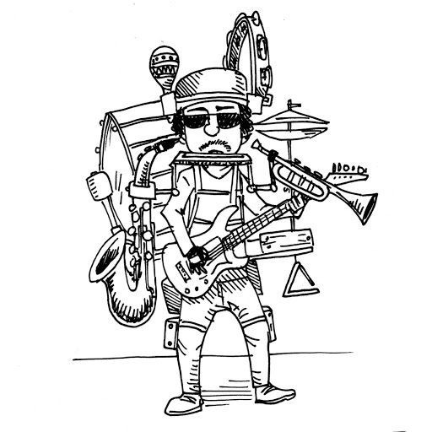









The Team
Product
Owner
Game
Designer
Artists
Quality Testers
Producer
Audio
Designers
Programmers
Notes:
So, what are the game production roles?
We have the Product Owner, who is the one sponsoring and funding the game;
The Producer tries to make everyone else’s job easier so that the team can run smoothly;
The Game Designer is in charge of gameplay and the overall play experience;
The Artists handle art assets, including characters, environment, icons and everything else visual about the game;
The Audio Designers are in charge of music and sound effects, which have a huge impact on the feel of the game;
The Programmers, well, they code the game;
And finally the quality testers, who test the game at all stages of development to provide valuable feedback during development.
In major game companies, each person will likely have one specialized primary role, whether they are a programmer, designer, or artist. For smaller teams, all of these roles are still filled, but people take on multiple roles. In fact, it is possible for one person to take on all these roles (sort of like a one-man band), so when we discuss these roles, think of them as job responsibilities rather than individual people.

Slide 3

Team Dynamics
Share common vision and goals
Everyone is involved from the beginning
Organised and systematic
Team player
Respect for each other
Efficient, constructive and productive workflow
Keeping the morale
Notes:
We will talk about these roles one at a time, but first, let’s talk about some common qualities of successful game production teams.
In the ideal situation, we want everyone in the team to be involved from the beginning. Everyone shares in the vision of the game, and they are working together to achieve that vision. They understand their roles, and there is a plan and a timeline in place.
In a good team, all members in the team respect each other. They help each other with their daily tasks and inspire each other to continue productivity. And when the deadlines approach and the stress rises, they encourage each other to keep the spirits up. The ideal team are friends and comrades with a common aim, which is to build the best game possible.

Slide 4
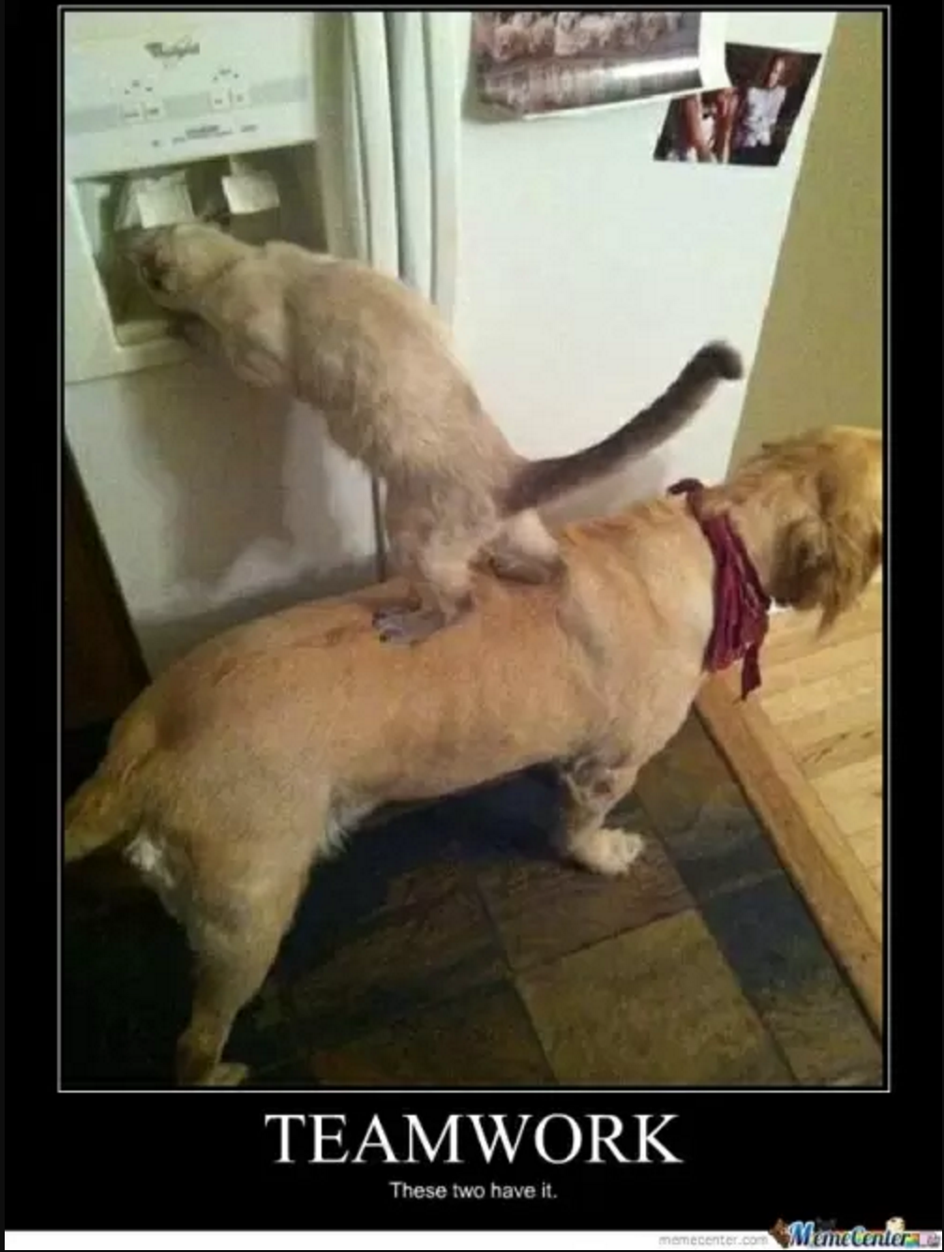
Common Attributes
Good communication skills
Open to criticism, comments and feedback
Resolve issues
Creative and innovative
Independent learner
Continuously upgrading self
Flexibility to adapt to changes
Motivated and self-driven
Notes:
Every member of a game production team should ideally have the following characteristics.
Firstly, they must have good communication skills. This includes both the ability to give criticisms without offending the other person, and to receive criticisms without getting offended. In game development, where everyone has their own slightly different ideas of what is the best way to make the game, there will definitely be differences in opinion, and it is important for the team to find a good way to resolve these issues.
They should be creative and innovative. Games development often requires new ways to solve problems. The game may have a fresh new game mechanic, which presents a programming challenge, or a new story that requires the artists to envision an imaginary person (or an alien creature with 17 arms and 12 mouths or something). If you want to work in game development, you should enjoy problem solving and tackling new challenges.
Which means that you need to be an independent learner, to pick up the latest technologies, software and techniques. You might even have to invent some new techniques yourself as you face challenges unique to your game design that nobody has really faced before.
It is also crucial to be able to adapt to changes. In games, the design can change rapidly depending on playtesting and feedback. There may also be technology changes, like the announcement of a new OS or platform. Or someone may just have a new gameplay idea that everyone thinks is amazingly cool. You have to be flexible and adapt quickly.
Finally, you have to be passionate about games and have a thirst for learning. While the starting pay for a games developer is higher than the average for the IT industry, considering the long hours that you will spend during crunch time to meet that production deadline, you are not necessarily getting more per hour. Burnout is a real issue. If you are not passionate about games and just want a well-paying job, the games industry is probably not for you. There are easier ways to make money.
The good thing is that you will not be in this alone. All your colleagues will be just as passionate as you, and by working together you can get that game done, and done well.

Slide 5


Product Owner
Owns the product (i.e., the game)
Has the vision for the game
Has a purpose for the game
Concerned about the money and risk involved
Might be game publisher or private investors
May have had the initial idea about how the game will be like
Sets base requirements
Notes:
Now let’s talk about the Product Owner.
The product owner is the one who pays for the project, and as a result ultimately owns the game. The owner often has a vision and/or purpose for the game. They also are very much concerned about their return on investment.
The product owner might be a game publishing company whose business is to sponsor game studios financially and make money out of their investments. They may also have marketing and distribution channels. We will talk more about publishers in a later lesson. However, a product owner may also just be a single private investor who pays the team to make a game.
Quite often, the product owner might have an initial idea for the game to set the base requirements. They may want a casual match-three mobile game with a cat theme, or a rogue-like RPG targeting hardcore gamers, or they may even be a museum who wants a game to teach people history. However, they are unlikely to have their design fully fleshed out, and will leave the details to the team. That being said, you have to listen to their opinions, because the product owner is the one paying the wages.

Slide 6

Producer
3 Key Responsibilities
The Team
The Process
The Product
Video: Extra Credits - So You want to be a Producer (www.youtube.com/watch?v=WUkcz2taCiw)
Notes:
Next, let’s talk about the Producer, who is the one who makes sure that everybody else’s job is easier. You can think of a producer as a project manager, but more. So he’s a project manager plus plus. Plus plus plus.
The producer has 3 key responsibilities. He needs to make sure that the team has everything it needs to do its job at maximum efficiency; he must monitor the process of game development to make sure that checkpoints are reached on time and within budget; and of course, he must make sure that the game itself is of high quality and doesn’t morph over time into something unrecognizable from the initial design.
If you want to learn more about being a Producer, the YouTube channel Extra Credits has an excellent video about it. In fact, I highly recommend watching the Extra Credits channel for thorough, informative and entertaining videos about the game industry. I really like these videos, and I would make my own versions if I could draw. Hmm, maybe instead of drawing, I can just grab pictures and memes from Google images. Hmmmmm.

Slide 7
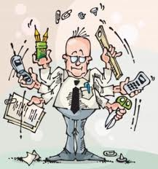
Managing the Development
Project manager responsibilities
Scope of the project
Vision of the game owner
Morale of the team
Daily activities include:
Running daily updates (standups) and updating project documents
Managing resources and communications
Checking schedules and milestones
Hardly any time for hands-on development
Notes:
Anyway, back to the Producer role. Like I mentioned, the producer has project manager responsibilities, which is to keep the scope of the project on track such that it matches the vision of the project owner, and to keep the morale of the team high. The producer has a high-level view of the entire project, and so he knows where to cut corners and where to stand firm because that part of the project is mission-critical.
His daily activities include monitoring the project progress and updating documents; monitoring the budget; resolving issues; and ensuring that milestones are reached. There will also be plenty of ad-hoc issues that pop up, from disagreements between team members to software licensing issues to people having to take emergency leave due to unforeseen circumstances. The best producer is someone with good knowledge of every aspect of the game development process so that they can help to solve problems, organizational skills to handle scheduling and budget issues, and the people skills to mediate disagreements and raise morale.
Make no mistake, being a producer is a full-time job, and in any decent-sized game project, the producer will have hardly any time for hands-on development.

Slide 8
Game Designer
Makes the game fun!
Design the content
Design the rules systems and goals
Set game boundaries
May design levels
Article: So you wanna be a game designer (http://asia.gamespot.com/features/so-you-wanna-be-a-game-designer-6129276)
Video: Developing the Game, Designing the Levels (www.youtube.com/watch?v=F8GMjQyFzEM)
Notes:
And then there is the game designer. The game designer is the one with the overall vision of what the game should be, and it’s his responsibility to make the game fun. This sounds easy, but it is a huge undertaking.
The designer needs to figure out the content of the game, including the overall story, the look and feel, and the game mechanics. He designs the rules systems, like the combat system, skills, inventory, items, monsters and NPCs. This also includes the game boundaries, or what the player CANNOT do. The game designer may also design individual levels, and he can inject creativity into the level design to take advantage of the game mechanics.
Here I provide you with a couple of links. One is an article on GameSpot on what it means to be a game designer, and the other is a short video about the level design in Halo.

Slide 9
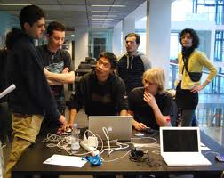
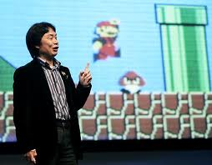
It’s About the Vision
Skillsets include:
Understanding the player
Understanding the team capabilities and limitations
Embracing the game to be built
And not your own
Grasp of technology, tools and prototyping
Excellent communication skills
Notes:
The game designer has a huge number of responsibilities, and I am just scratching the surface here.
The game designer needs to understand the type of player that his game is supposed to appeal to: if the target audience is casual gamers with half an hour a day to play, or competitive players involved in e-sports, or bored teenagers stuck at home during Covid-19, the game he designs can be very different.
He must understand the capabilities of his team, both strengths and weaknesses – if he has an excellent team of 2D artists, he should not be designing a 3D game unless there is a very good reason. And if he has a small team of 4 people and 3 months to complete a game, it probably shouldn’t be an MMORPG.
He needs to embrace the game to be built, because the vision of the game belongs to the product owner. Sure, he might really be a sci-fi fan who wants to make a grand space exploration game, but if he’s making a game to help McDonald’s sell more hamburgers, that’s probably not the game to make.
He must have a good grasp of technology and know their strengths and limitations. A design meant for PCs is different from one for a console or a mobile device. Should the game be made using a game engine like Unity or Unreal, or should it be coded from scratch using DirectX or OpenGL? He should also be able to quickly prototype his ideas, either digitally or simply using pencil and paper. This would allow him to communicate his game idea to both potential investors and the development team. Overall, he needs excellent communications skills.
Bear in mind that this is by no means an exhaustive list of skills required to be a game designer. There are entire diplomas and degree programmes on game design.

Slide 10
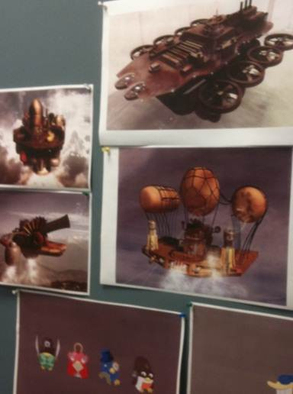
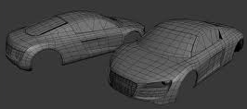
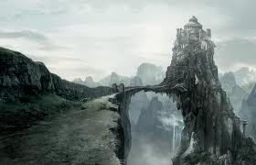
Artists
Creates the visuals for the game
Talented and creative
May specialize in
Characters
Environment
Modeling
Cinematography, lighting
Textures, effects, user interface, etc.
Notes:
Artists are the ones who create the visuals for the game. Based on what the game is about, the artists will conceptualize, design, sketch out and ultimately digitally draw all the art assets in the game.
Most artists specialize in certain areas of game art. There are character artists, who are good at creating game characters, including playable characters, NPCs and mobs. Environment artists develop the game surroundings, from outdoor areas with forests and mountains to indoor scientific labs or underground dungeons.
There are artists who specialize in the modeling aspects, especially in 3D games. It takes skill to create a model that can be manipulated in the game using the minimum number of polygons to speed up processing, and yet be attractive and realistic enough to satisfy the discerning player.
There are also those who handle the traditional filmmaking and storytelling fields of cinematography, which is how the scene is framed and the panning of the camera and so on, and things like lighting, colour filtering, scene direction and so on.
We also have artists specializing in textures, water and particle effects, user interfaces, icons and other visual aspects. With the increasing popularity of technologies such as virtual reality and augmented reality, there is greater and greater demand for technologically proficient artists in the game industry.
Video: Art of War 3: Lead Cinematic Environment Artist (www.youtube.com/watch?v=0ZClqsF7G4g)

Slide 11

Drawing for the Game
Awareness of game designers’ goals
Aids game designer in early game conceptualisation
Technical limitations
Not everything can be done
Awareness of time required to complete work
Lots of sketching and drawing
Creating and refining art assets
Possibly need to re-work a few times
Bringing it to digital life
Notes:
Of course, game artists are different from traditional artists or graphic designers, although there is some skills overlap. A good game artist must always bear in mind the game design, and often helps the game designer conceptualize the initial game design with quick concept sketches.
They must also be aware of technical limitations of the game engine and platform, and know where to compromise visual quality for the sake of better gameplay.
Ultimately, though, a game artist must be trained in traditional fine arts skills such as drawing, sketching and colouring because there will be lots of trial and error and discussion before an art concept gets put into the actual game.
Beyond that, the modern game artist needs to be able to transfer that sketch on paper onto the computer screen. This means that a good game artist needs both the left brain skill of technical competence as well as the right brain skill of creativity and art.

Slide 12
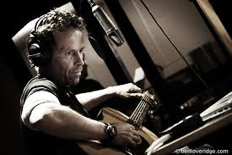
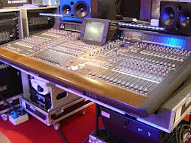
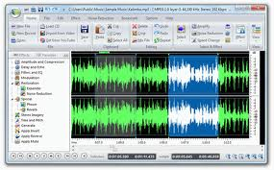
Audio Designers
Creates the sound effects and music for the game
Talented, creative and innovative
Pairs the audio created to the scene
Video: Making Batman: Arkham City – Sound Effects (www.youtube.com/watch?v=1E9BxBcnMCo)
Notes:
Many of the high-budget, AAA games today have an almost movie-like quality, and for those types of games they have full-time audio designers. These are the people in charge of the audio aspects of the game, from music to sound effects to ambient noise. You can take a look at this short video showing how the sound effects of Batman Arkham City were produced.

Slide 13
Sound of the Game
It is an essential part of the game
Cannot be treated as an afterthought
Sound is discussed at the beginning of game design
Audio designer is involved from the beginning
As the caretaker of the sound,
Creating and refining audio assets
Communicating with programmers on the ‘fit’
Notes:
For most games, sound is an essential part that should not be treated as an afterthought. Both the music and sound effects have a dramatic influence on the feel of the game. A moody score is appropriate for a gritty, dark game like Batman, but a cheerful cartoony game like Mario needs a much more lively score. Sound effects are just as important, like the sound alert of a guard noticing you in Metal Gear Solid or the simple Minecraft button click helps to put the player in the proper frame of mind.
Ideally, the feel of the game as communicated by the sound is discussed at the beginning of the game design.
The audio designer is the caretaker of the sound. As the game is developed, the audio designer must monitor the sound needs, creating sound effects and composing music as appropriate. They may also be involved in recording and directing voice-overs. Ultimately, for complex games, the audio designer is an integral part of the game development team.

Slide 14
Programmers
Write code and make the game!
Integrates all assets to create the game
Writes code, tests code and documents code
Technically competent
Awareness of technical limitations
Awareness of time required to complete work
Have to wait for others to complete their work before you can start
More to come in Gameplay Programming (GPP)
Notes:
And of course, we have the programmers, which is the role that all of you will be training in if you continue in this Area of Interest. Programmers integrate all the art and sound assets together to create the game. They need to write, test and document the code, and they are the ones that transform the game design from concept into reality.
Programmers need to know the technical limitations of the game engine, platform and algorithms, and they need to advise the game designers and other team members when there will be an issue in the game implementation. They must be efficient and productive, because they are often the final step in a process.
Of course, there is a lot more to the game programmer role. If you are interested (and if what we do in Game Production doesn’t scare you away), you will learn a lot more in the Gameplay Programming module.

Slide 15
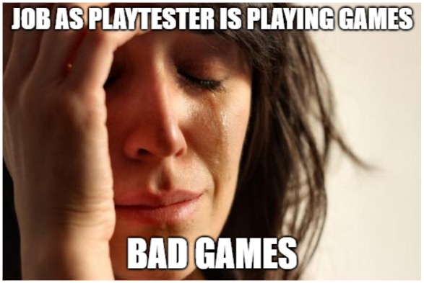
Quality Testers
Quality Assurance
Test the game
Locate bugs and errors
Describe the bugs
Decide if it is worth fixing and when
Eventual fate of the game lies on the testers
Testing starts from the beginning
Video: God of War II - Testing the Game (www.youtube.com/watch?v=xkNNdkBOwwM)
Notes:
Finally, we have the quality testers, sometimes called QA (or quality assurance) testers. Their responsibility is to test the game for bugs, and also provide feedback on whether the game is fun. For bug fixes, they should ideally be able to reproduce and document the bugs, and perhaps even suggest possible causes of the bugs. This is why it is useful to be technically competent as a QA tester.
Note that quality testing happens throughout development, and all team members can play the role of quality testers.
You might want to take a look at this video about a playtesting session for the game God of War 2.

Slide 16
Testing the Game
Understand the game thoroughly
Knows what to test, why there is a need to do so, when to test and how to test
Involved at the start of game conceptualisation
Possess excellent communication skills and people skills
Inquisitive and gives constructive feedback
Additional focus on usability and playability of the game
Notes:
In order to be an effective quality tester, you need to understand the game thoroughly. This will help you figure out what aspects are the most important to test and why, and also how to test it as well as at which stage of development should testing be done. This means that ideally, the tester should be aware and involved in the game conceptualization.
In addition, a good tester needs good communication skills so that they can give constructive and understandable feedback that is actionable. Feedback like “this game is not fun” or “this game is too hard” is not constructive or actionable. It is much better to identify how the game can be improved or fixed, and have persuasive reasons for your views.
Apart from game-breaking bugs, testers are also concerned about the usability and playability of the game, in other words, how fun the game is. And while fun is subjective, testers must be able to understand the target audience and get into their heads in order to help the team make the game more fun FOR THAT AUDIENCE. Game testing is something that you can do right now, just by signing up for beta tests and providing insightful feedback to the developers of current games. It is not uncommon for really good public open playtesters to be offered a full-time position in a game development company.
We will talk more about playtesting in a later lesson.

Slide 17
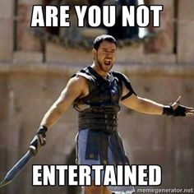
Summary
You should have a better understanding of:
Game production roles
Product Owner
Producer
Game Designer
Game Artist
Audio Designer
Game Programmer
Quality Tester
Notes:
And we’re done. You should now have a better understanding of game production roles, specifically the product owner, producer, game designer, game artist, audio designer, game programmer and quality tester. Game development is a major industry that requires committed teams of talented people passionate about their craft. It’s a challenging but rewarding field. And you get to make games. Cool, isn’t it?

